Slide 1
Coding Inequalities PEA 516 Lecture 24

Slide 2
Contents
Problems on inequalities and comparisons
Problems on interchanging operators
Problems on reverse operations

Slide 3
1. Direction: Two equations (I) and (II) are given in each question. On the basis of these equations. You have to decide the relation between 'x’ and 'y’ and give answer.
If x < y
b) If x ≥ y
c) If x > y
d) If x = y or no relation can be decided between 'x’and 'y'.
e) If x ≤ y
x = (1764)^{1/2}
y² = 1764
Notes:
Level: Easy
Option B

Slide 4
2. Direction: Two equations (I) and (II) are given in each question. On the basis of these equations. You have to decide the relation between 'x’ and 'y’ and give answer.
If x < y
b) If x ≥ y
c) If x > y
d) If x = y or no relation can be decided between 'x’and 'y'.
e) If x ≤ y
x² -16x + 63 = 0
y² - 2y - 35 = 0
Notes:
Level: Easy
Option B

Slide 5
3. Direction: Two equations (I) and (II) are given in each question. On the basis of these equations. You have to decide the relation between 'x’ and 'y’ and give answer.
x > y
x < y
x ≤ y
x ≥ y
x = y or no relation can be decided between 'x’ and 'y'.
x² –6x+135 = 0
y² –30y+225 = 0
Notes:
Level: Moderate
Option C

Slide 6
4. Direction: Two equations (I) and (II) are given in each question. On the basis of these equations. You have to decide the relation between 'x’ and 'y’ and give answer.
x > y
x < y
x ≤ y
x ≥ y
x = y or no relation can be decided between 'x’ and 'y'.
6x² +77x+121=0
y² +9y−22=0
Notes:
Level: Moderate
Option E

Slide 7
5. Direction: Two equations (I) and (II) are given in each question. On the basis of these equations. You have to decide the relation between 'x’ and 'y’ and give answer.
x > y
x < y
x ≤ y
x ≥ y
x = y or no relation can be decided between 'x’ and 'y'.
(x–8) (2y+9) = 25
(2x–16) (y–4) = 8
Notes:
Level: Moderate
Option A

Slide 8
6. Direction: Two equations (I) and (II) are given in each question. On the basis of these equations. You have to decide the relation between 'x’ and 'y’ and give answer.
x > y
x < y
x ≤ y
x ≥ y
x = y or no relation can be decided between 'x’ and 'y'.
x² –15x–364 = 0
y² +31y+240 = 0
Notes:
Level: Moderate
Option A

Slide 9
7. Direction: Two equations (I) and (II) are given in each question. On the basis of these equations. You have to decide the relation between 'x’ and 'y’ and give answer.
x > y
x < y
x ≤ y
x ≥ y
x = y or no relation can be decided between 'x’ and 'y'.
13x - 8y + 81 = 0
15x + 5y + 65 = 0
Notes:
Level: Moderate
Option B

Slide 10
8. Direction: Two equations (I) and (II) are given in each question. On the basis of these equations. You have to decide the relation between 'x’ and 'y’ and give answer.
x > y
x < y
x ≤ y
x ≥ y
x = y or no relation can be decided between 'x’ and 'y'.
x² - 208 = 233
y² + 47– 371 = 0
Notes:
Level: Moderate
Option E

Slide 11
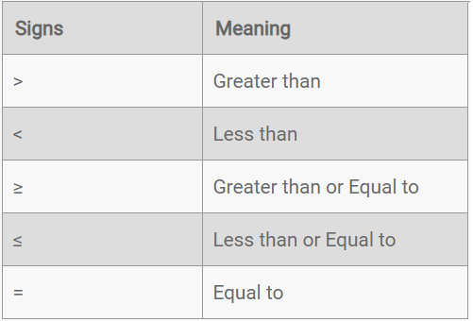
Equality means equal and inequality means there are five possibilities between terms/objects. Let us understand these types of possibilities through a table.

Slide 12
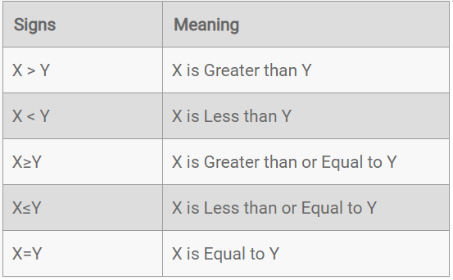
Let us consider two variables X and Y.

Slide 13
9. Directions: Study the following information carefully and answer the given questions. In which of the given expression does the expression F< N and R> M definitely hold true?
M≤ N< L; R> N; P< F ≤ L
M≤ N> L; R< N; P< F ≥ L
M≤ N> L; R> N; P< F ≤ L
M≥ N> L; R> N; P< F ≤ L
Notes:
Level: Easy
Option C

Slide 14
10. Directions: Study the following information carefully and answer the given questions. What is in the place of question mark (?) in the given expression does the expression K< H andV> K is definitely true?
V = O ≥L ? K; O ≤ H
>
=
< or ≤
≥
None of these
Notes:
Level: Easy
Option A

Slide 15
11. Directions: Study the following information carefully and answer the given questions. In which of the following expressions the expression ‘P ≤ M ’ would hold definitely true?
M ≥ R = N >S ≥ P = Q
Q ≥ M > N = W ≥ P < S
Q >M ≥ N = W ≥ P < S
W < P = N ≤ Q < M > R
N > Q = P < S ≤ R ≤ M
Notes:
Level: Moderate
Option C

Slide 16
12. In these questions, relationship between different elements is shown in the statements. These statements are followed by two conclusions:
If only conclusion I follows.
(b) If only conclusion II follows.
(c) If either conclusion I or II follows.
(d) If neither conclusion I nor II follows.
(e) If both conclusion I and II follow.
Statements: H ≥ O = U ≥ B < L = P; D < N = B ≥ S > K
Conclusions
I.K < L
II.H ≥ K
Notes:
Level: Moderate
Option A

Slide 17
13. In these questions, relationship between different elements is shown in the statements. These statements are followed by two conclusions:
If only conclusion I follows.
(b) If only conclusion II follows.
(c) If either conclusion I or II follows.
(d) If neither conclusion I nor II follows.
(e) If both conclusion I and II follow.
Statements: N > D ≥ F > J; E < L ≤ G< S < P < F; G > W
Conclusions
W < J
J ≤ W
Notes:
Level: Moderate
Option C

Slide 18
14. Directions: In each of the question, relationships between some elements are shown in the statements(s). These statements are followed by conclusions. Read the statements and give the answer
Statements: G >= B > D = F ; L < B < M
Conclusions:
M<L
G>L
D>L
F< M
A Only II follows
B Only I and III follow
C None follows
D Only II and IV follow
E Only I and II follows
Notes:
Level: Moderate
Option D

Slide 19
15. Directions: In each of the question, relationships between some elements are shown in the statements(s). These statements are followed by conclusions. Read the statements and give the answer
Statements: U >=R = C, C >= N > M
Conclusions:
R > N
U > M
R >= M
None follows
B. Only I follow
C. Only II follows
D. Only III follows
E. Only II & III follows
Notes:
Level: Moderate
Option C

Slide 20
Any Doubts???

